Slide 1
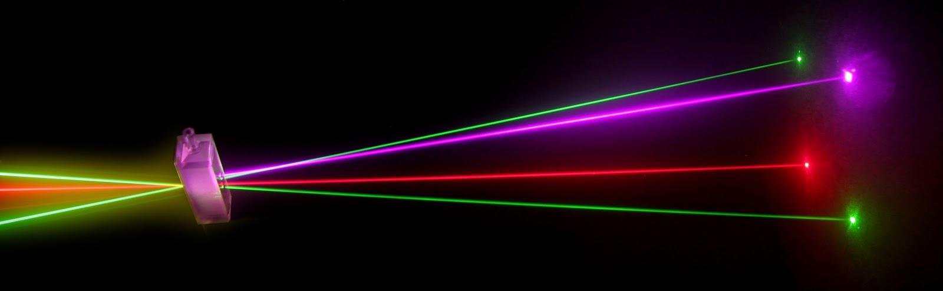
“Laser Technology and Applications” 16B1NPH533 Lecture 21-22

Slide 2
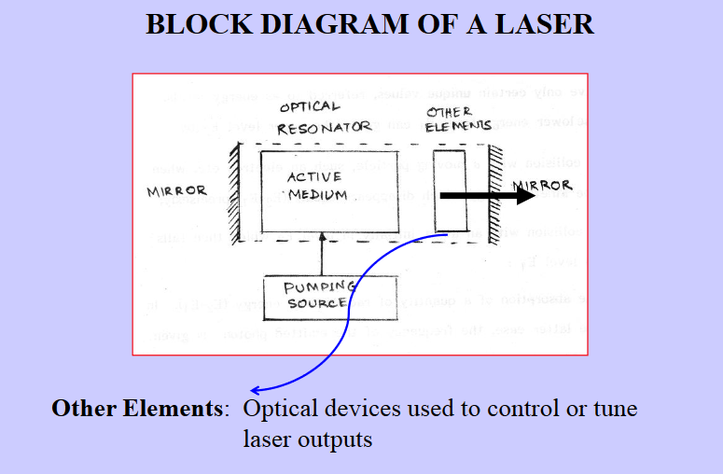
Lecture 21-22 Content Outlines
Techniques to control laser output
Need to control beam output
Selecting Single Frequency
Selecting Single Mode

Slide 3
Since conventional laser resonators have dimensions that are large compared to the optical wavelength
Hence the output may consist of various transverse and longitudinal modes leading to a greater divergence of the output beam as well as containing a number of oscillating frequencies.
In fact the power per unit frequency and solid angle interval is maximum when the laser oscillates in a single mode which is the fundamental mode.
In this section we will describe some techniques that are used to select a single transverse mode (well-defined transverse field pattern with minimal divergence) and a single longitudinal mode (small spectral width) of oscillation.

Slide 4
Laser Beams Modified either
• Inside the resonant cavity by affecting the process of laser oscillations
• Outside cavity by passing through a device with variable transmission.

Slide 5
Optical Devices
Passive devices:
➢ Prisms and gratings ; do same thing to light always.
Employed for
• Selecting a narrow range of frequencies or
• Tune the laser to operate at different specific frequencies
Active devices:
➢Rotating mirrors or optical modulators; do different things to light at different times.
Employed to
• Concentrate light energy into short time intervals - Pulses

Slide 6
Selecting a Narrow Frequency Range
A. From a Set of Frequencies
Some lasers emit light at a set of frequencies
Desirable that a laser oscillates only at a single frequency
For example:
He-Ne laser
Three laser transitions: 3.39 μm, 1.15 μm & 0.63 μm.
For many practical applications, required is ⇒ He-Ne laser that emits red light of 0.63 μm wavelength.
Simple method of obtaining the desired single frequency consists in suppressing the other possible oscillations.
In case of He-Ne Laser:
Mirrors are coated with materials having - High reflectivity at 0.63 μm - Low reflectivity for 3.39 μm and 1.15 μm wavelengths

Slide 7
Selecting a Narrow Frequency Range
B. From Wide range of Frequencies
Some of the lasers have broad emission lines consisting of a wide range of frequencies.
In such cases a single frequency can be selected using a prism or a diffraction grating, which is inserted in the resonant cavity.
A prism disperses the incident laser beam into components of different frequencies.
For a given setting of the prism, only one of the frequencies retraces its path into the cavity and gets amplified while other frequencies are lost.
In case of diffraction grating, the component which satisfies the grating equation,
λ=2dsinθ
reflected back into the cavity and the laser oscillates at wavelength λ.

Slide 8
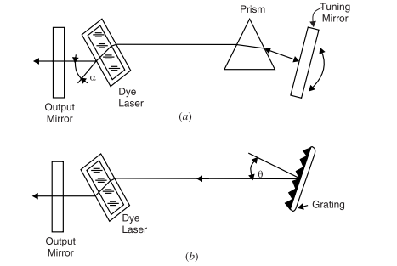
Frequency Tuning using:
a) Prism
b) Diffraction grating
The laser can be tuned to different frequencies within the laser emission line by rotating the grating.

Slide 9
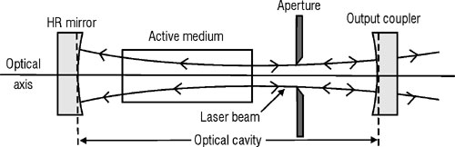
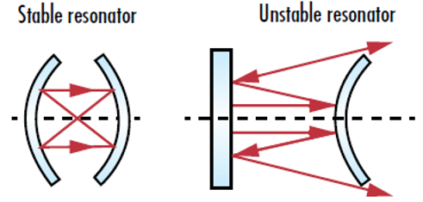
Selection of TEM and Single Longitudinal Mode
❑ Out of the large number of transverse modes, it is often desired to select only the Fundamental Mode i.e. TEM00
▪ Selected by keeping a Circular Aperture in the cavity
▪ Also by using an Unstable Optical Resonator
Example is a Con-focal Telescopic Resonator
Yield high coherent beams

Slide 10
Selection of TEM and Single Longitudinal Mode
Exhibit high diffraction losses leading to suppression of high-order transverse modes.
Even if the laser oscillates only in its fundamental transverse mode, there exist a large number of longitudinal modes.

Slide 11
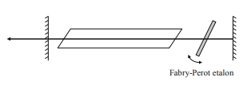
Selection of TEM and Single Longitudinal Mode
A simple method of obtaining single longitudinal mode is by reducing cavity length
However, in this method the output power is reduced.
Single axial mode oscillation may be achieved without reducing the cavity length, if a Fabry-Perot Etalon is placed in a titled position with in the cavity,

Slide 12
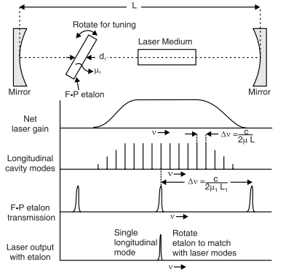
Selection of TEM and Single Longitudinal Mode
Only one mode is sustained because it has more transmission through the etalon while other modes are reflected and attenuated.

Slide 13
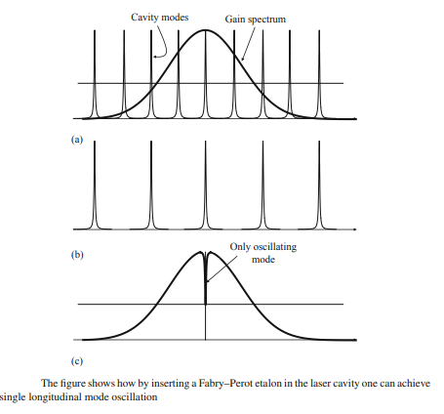
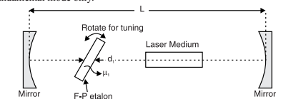
Selection of TEM and Single Longitudinal Mode

Slide 14
